Slide 1
Phase Shift Keying Modulation
Yuen Fuat Chew 27997723
Surya Kannan 29741149
17/05/2021

Slide 2
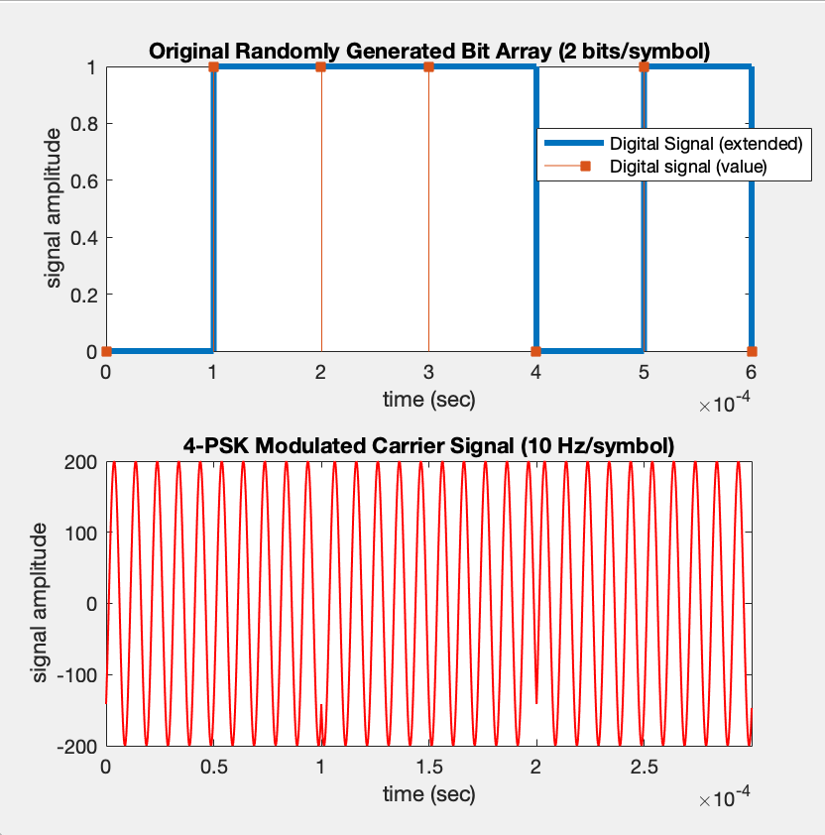
Background
Physical layer -> responsible for bit transmission
Carrier waves and their characteristics
Modulation of carrier wave occurs using phase shifting depending on “M” level
Information Source
Transmitter
Channel
Receiver
Information Destination
Random Bit Generator
M-PSK Modulator
AWGN
M-PSK Demodulator

Slide 3
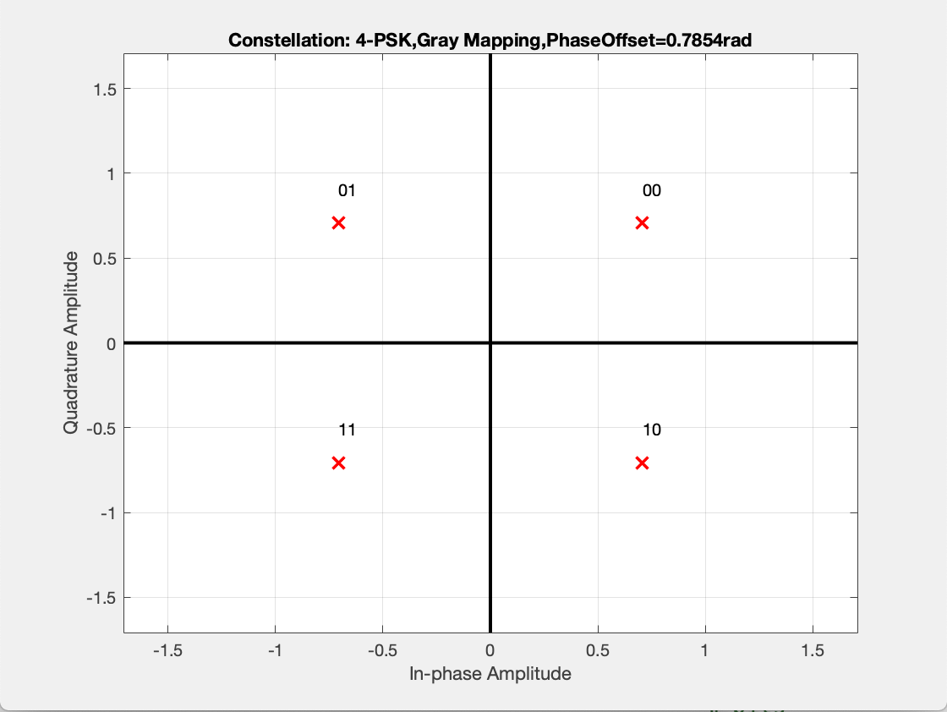
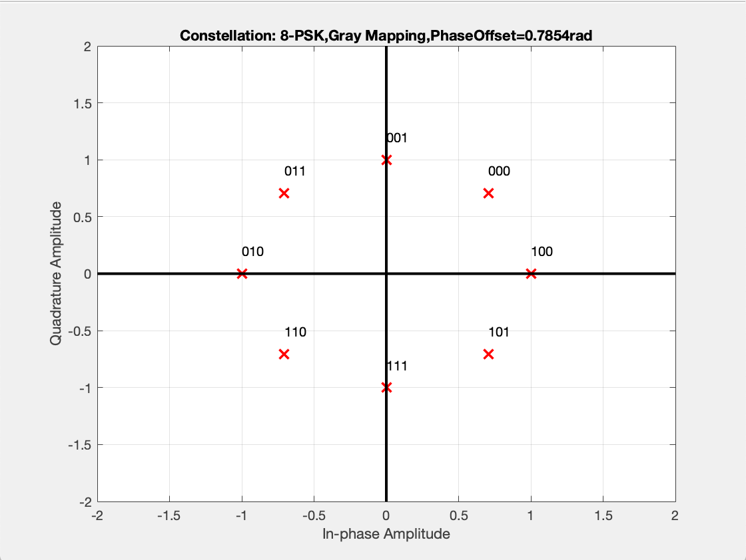
Process
Equally spaced around complex plane with Gray code mapping
These are the ideal phases that the modulated carrier signal should consist of (before passed through AWGN)

Slide 4
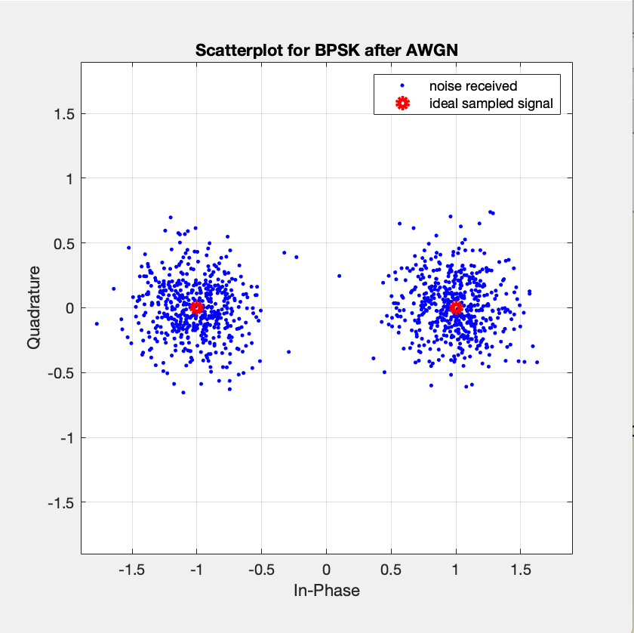
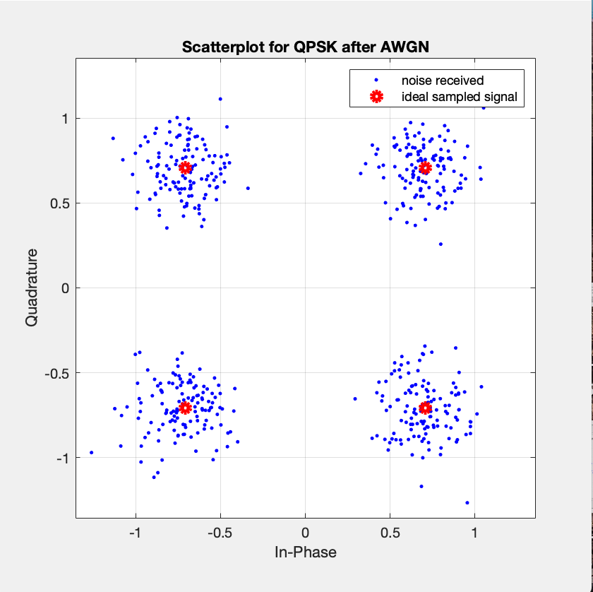
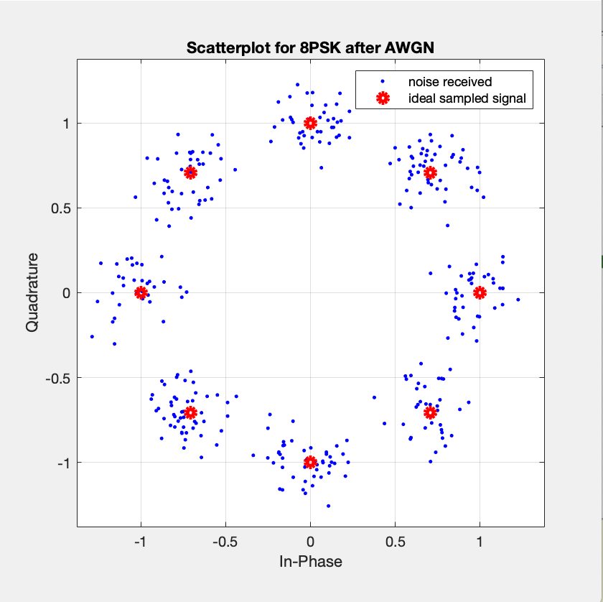
Signal constellation plot for 2,4,8- PSK
By adding noise, the modulated signal now has non-ideal phase shifts

Slide 5
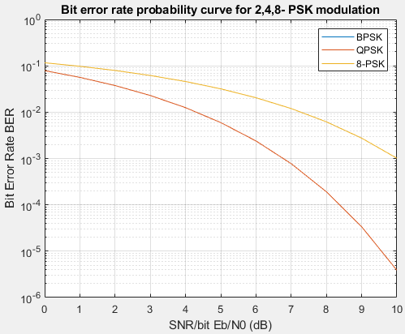
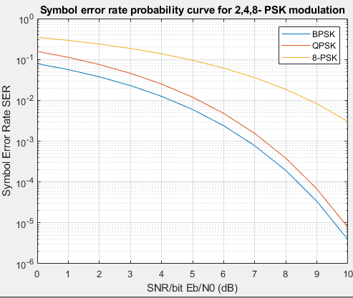
BER and SER for 2,4,8-PSK
BER and SER decrease rapidly with smaller M
BPSK has same BER and SER
BPSK and QPSK have the same BER

Slide 6
Signal constellation plot for 2,4,8- PSK
M increases - signals pack more closely
Threshold that differentiates phases between symbols is smaller

Slide 7
Why BPSK and QPSK have the same BER
PSK_{i}
x
Carrier
+
QPSK Output
Digital
data
Odd Bits
Even Bits
𝜙
Phase Shifter
Bit splitter
x
PSK_{Q}
QPSK - a pair of orthogonal BPSK system

Slide 8
Bandwidth efficiency (M increases)
Bandwidth efficiency = log2(M) bits/s/Hz
M | Bandwidth efficiency (bits/s/Hz)
2 | 1
4 | 2
8 | 3
Larger M - better utilisation of bandwidth

Slide 9
Choice of M
Requirement of application | Large M | Small M
Data transmission rate | At the same bandwidth
 | Increase | Decrease
Error tolerability | High | Low
Bandwidth | At the same transmission bit rate.
 | Decrease | Increase

Slide 10
Thank you for listening

